Slide 1

Effective Paragraph Writing

Slide 2



Designing effective paragraphs
Audience
Purpose
unity
COHERENCE
development
Who are you writing for?
Why are you writing?
Is my writing focused on one topic?
Are ideas connected logically?
What are different ways of developing paragraphs?

Slide 3

SUBJECT
Subject of any writing
Topic/ Central Idea
Clarity of subject
What do you want to talk about?
Delimitation of idea

Slide 4

Audience
The writers intended readers
Audience analysis
Helps develop effective content
Good writers learn about their audience
Assess how receptive people would be to their ideas
Ask yourself
What to readers already know about the subject?
Will they be in agreement with my ideas?

Slide 5
Purpose: The writers intention
ENETRTAIN
INFORM ATION
PERSUASION
You want to entertain your audeince
Tell a great story
Presentation of facts
You want to inform your audience about
Something ongoing
Historical events
Tries to convince the audience
to agree with their perspective
Seeks to change behavior
Examples
Newspaper Editorail

Slide 6

PRACTICE EXERCISE
Understand purpose in writing. Identify what is the writers purpose in the given subjects.
Why professionals need to be on LinkedIn
History of the Kashmir conflict
My video game skills should land me a great job
Why I am not going for a traditional 9-5 job
Using MOOC’s to develop your skillset
There should be a competitive exam like CSS for politicians too
The process of filing taxes

Slide 7

PRACTICE EXERCISE
Identify the Audience and Purpose for each subject written. Justify your answer logically
Description of two history courses
Instructions for installing a software
A proposal to setup a place for vocational training and education for underprivileged people of the area
Report and suggestions on how to reduce hate speech in online spaces
My so-called job
Prevention from dengue virus
A letter to the local newspaper about the importance of public libraries

Slide 8

UNITY
Are all ideas connected to the central theme?
Every detail written
Should develop the main idea
Even the examples
All parts of the writing makeup the whole work
Make your work impactful
Writing feels complete
Reader does not feel that something is missing

Slide 9

PRACTICE EXERCISE
The following paragraph lacks unity. Read the paragraph and cross out any sentences that do no contribute to the unity of the work.
Many parents fear the time when their children reach adolescence. When that time does come, some parents are afraid to give their children freedom to make choices. These same parents do not admit that their children have any ideas or feelings that are valid. Many adults like to look back on their own childhoods. Pets are often remembered fondly. Conflicts between parents and adolescents are bound to develop. Some conflicts, of course, are a sign of healthy development within the family. Psychologists say that parents should not be fearful when teenagers challenge authority. Challenging authority is a normal part of the maturing process. Adults without children have none of these concerns. The need for privacy is also normal during adolescence and should be respected rather than feared. On the other hand, when the right moment comes along and a teenager wants to talk, parents should not miss the opportunity to connect. Sometimes teenagers and their younger brothers and sisters fi ght continually over the most trivial things. Most important of all is the need for parents to be sensitive to the feelings of their teenagers. Remember, adolescence does not last for a lifetime, but a good relationship between parent and child can!

Slide 10

COHERENCE
Clear and logical progression of thoughts
Requirement of good writing
Careful organization of ideas
To show connectivity, writers use
Repetition of key words
Synonyms and pronouns
Transitional expressions

Slide 11

Example for Coherence
Sometimes even the most ordinary products can benefit from buzz. Remember Hush Puppies? When the company discovered that hip New York City kids were snapping up vintage pairs of its Hush Puppies at secondhand stores, it rushed into action. It began making its shoes in shades like Day-Glo orange, red, green and purple. Next, it sent free samples to celebrities, and not long after, David Bowie and Susan Sarandon were spotted wearing them. Then the company tightly controlled distribution, limiting the shoes to a handful of fashionable outlets. Soon high-end retailers like Saks, Bergdorf Goodman, and Barneys were begging for them. In just three years, from to 1996, Hush Puppies saw its annual sales of pups in North America skyrocket from fewer than 100,000 pairs to an estimated 1.5 million.

Slide 12
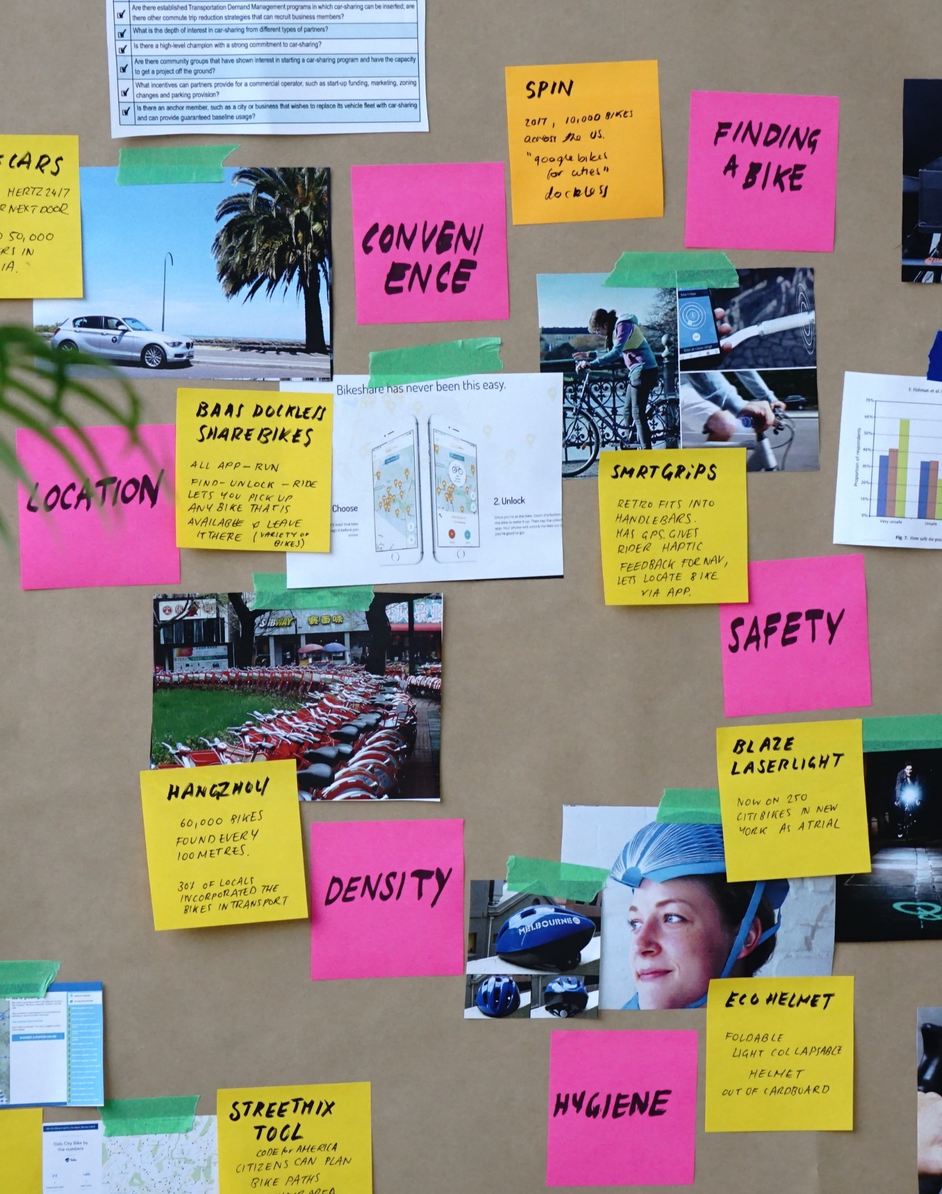
PRACTICE EXERCISE
Read the paragraph and identify which techniques are used by the writer to create coherence.
More than one billion web pages currently exist online and are accessible to the public. These pages are not numbered. They are not organized. They do not come with a table of contents or an index. It is as if people around the world took all their books and magazines, ripped out all the pages, and dumped them into one gigantic pile. In the past five years, that pile has grown bigger and bigger and bigger. So how do you find your way through this maze of information? The answer is search engines. As with any technology, some very smart people have devised new search engines for the Internet, based on the lessons of the previous generation. Names like Google, Yahoo!, and Alta Vista have become well known. They will likely be your best bet for quickly finding what you need on the web.

Slide 13

Development
Effective writing (paragraph/essay)
Fully developed
Does not leave any question in the readers mind
Like a well developed map
Readers are able to trace development of idea presented
Add relevant details
Use appropriate pattern of development

Slide 14
DEVELOPMENT: EXPLAINING IDEAS
Provide Right Level Of Details
Provide Right Kind of Details
Right Pattern of Development
Have relevant details
Readers can understand what is going on
Ask WH questions
See if the readers can follow what you have written
All details found during research
May not be relevant to your work
Understand the purpose of writing
Historical/ Statistics/ Description
Appeal to logic and emations
Select appropriate pattern
Depend on the purpose of writing
What do you want people to know
Story/facts/ Personal Experience

Slide 15

Writing continuum
CREATIVE
NARRATION
DESCRIPTION
PROCESS
EXEMPLIFICATION
COMPARISON/CONTRAST
DEFINITION
ANALYICAL
CAUSE/ EFFECT

Slide 16

Audience | Possible Writer | Possible Topic | Appropriate choice of Voice
The Supreme Court
Internet Discussion Forums
University Admission Panel
Editor of the Newspaper
Blog Followers
Last semester students

